Slide 1
Introduction to EPICS
Andrew Johnson
Computer Scientist, AES-SSG

Slide 2
What is EPICS?
A Collaboration
A Control System Architecture
A Software Tool-kit

Slide 3
What is EPICS?
A Collaboration
  Began in 1989 between LANL/GTA & ANL/APS
    (Bob Dalesio & Marty Kraimer)‏
  Over 150 license agreements were signed before EPICS became “open source” in 2004
  Recent EPICS collaboration meetings
    100+ Attendees
    30+ Institutions
    75+ Presentations
  Mailing lists tech-talk and core-talk show the collaboration in action
  Collaborative efforts vary
    Joint development of new software
    Assist in finding bugs
    Annual Codeathon (Code Sprint)
    Share tools, schemes, and advice

Slide 4
What is EPICS?
Major Collaborators
  ANL (APS Accelerator, APS Beamlines, IPNS)‏
  LANL (LANSCE)
  ORNL (SNS)‏
  SLAC (SSRL, LCLS)‏
  HZB (BESSY-2)
  PSI (SLS)‏
  DIAMOND Light Source
  The Australian Synchrotron
  KEK
Recent Collaborators
  ITER

Slide 5

What is EPICS?
A Collaboration
A Control System Architecture
  Network-based “client/server” model (hence the logo)‏
EPICS
CA
CA
Client
Client
CA
CA
Server
Server
For EPICS, client and server speak of their Channel Access role
i.e. Channel Access Client & Channel Access Server

Slide 6
What is EPICS?
Channel Access clients need to access Process Variables to carry out their designated tasks
StripTool
MEDM
CAC
CAC
Process
Variables
Process
Variables
CAS
CAS
A Channel Access server gives its clients access to its Process Variables

Slide 7
What is EPICS?
Process Variable (PV)
  A Process Variable is a named piece of data associated with the machine (e.g. status, readback, setpoint, parameter)‏
  Examples of PV names and values:
    S1:VAC:reading 3.2e-08 torr
    LINAC:BPM4:xPosition -0.323 mm
    BOOSTER:gateValvePosition ‘OPEN’
    S3:DIPOLE:PS:setPoint 123.4 Amps
    APS:Mode ‘Stored Beam’
    BL3:HISTOGRAM {3, 8, 1, 2, 56, 44, 32, 43, 3, 5, 1}

Slide 8
What is EPICS?
Process Variable
  A Process Variable is a named piece of data with a set of attributes
  Examples of Attributes:
    Alarm Severity (e.g. NO_ALARM, MINOR, MAJOR, INVALID)‏
    Alarm Status (e.g. LOW, HI, LOLO, HIHI, READ_error)‏
    Timestamp
    Number of elements (array)‏
    Normal Operating Range
    Control Limits
    Engineering Unit Designation (e.g. degrees, mm, MW)‏

Slide 9
What is EPICS?
A Control System Architecture
  Network-based “client/server” model where the basic data elements are Process Variables
  The Channel Access Protocol defines how Process Variable data is transferred between a server and client
  The entire set of Process Variables establish a Distributed Real-time Database of machine status, information and control parameters
Process
Variables
Process
Variables
Process
Variables
Process
Variables
Process
Variables
CAS
Process
Variables
Process
Variables
Process
Variables
Process
Variables
Process
Variables
CAS
CAS
CAS
CAS
CAS
CAS
CAS
CAS
CAS

Slide 10
What is EPICS?
By default, Channel Access traffic is constrained to a single TCP/IPv4 subnet, but configuration options can direct traffic elsewhere
Physical hierarchies can be implemented using standard network switches and routers, and CA Gateways
Gateway

Slide 11
What is EPICS?
Any program that uses the Channel Access protocol can be regarded as “EPICS Compliant.”
My Special Data Collection Program
StripTool
MEDM
CAC
CAC
CAC
EPICS is a tool-kit of programs that are EPICS Compliant or associated with other such programs. Users can select existing tools that match their needs, or develop new tools.
My Accelerator Simulator Code
(PVs)‏
iocCore
(PVs)‏
LabView
(PVs)‏
CAS
CAS
CAC
CAS
CAC

Slide 12
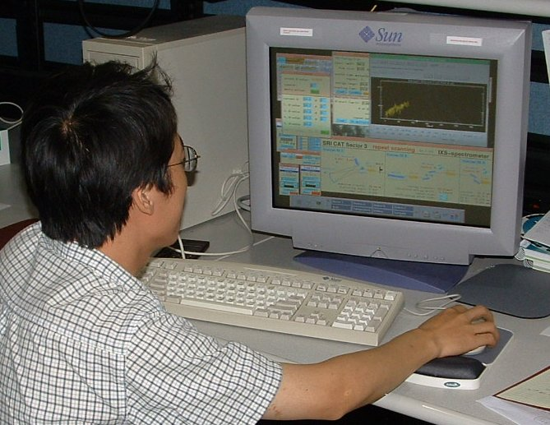
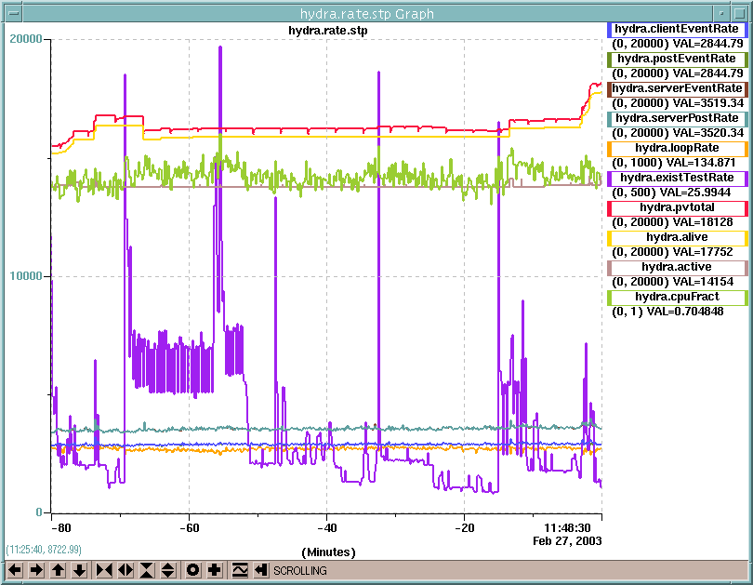
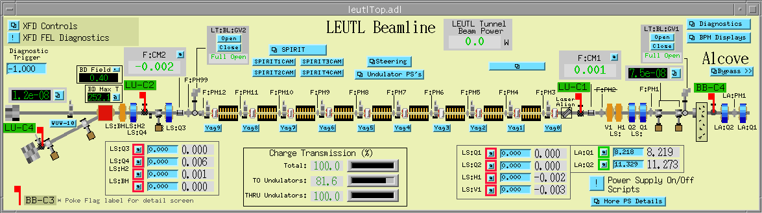
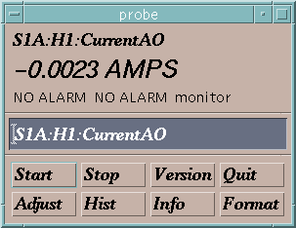
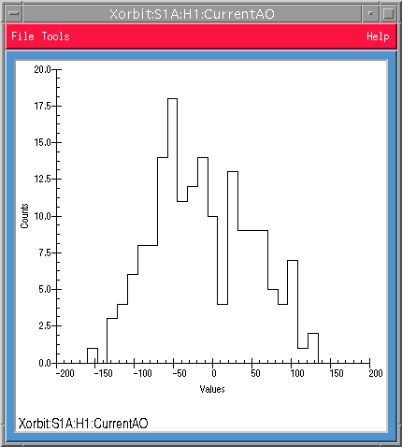
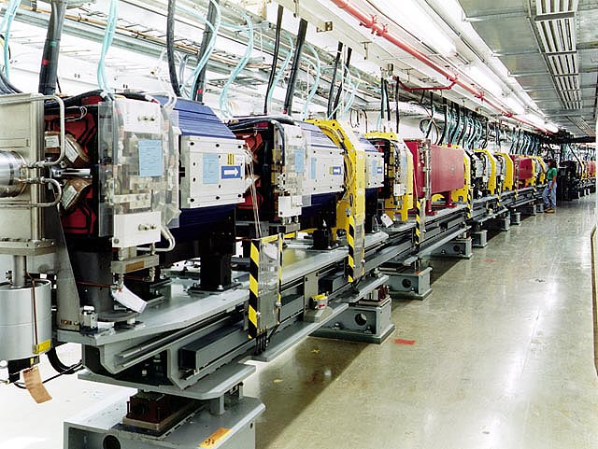
How does it do it?
Channel Access Client
Channel Access Client
Channel Access Client
Channel Access Client
Channel Access Server
Process Variables:
Computer Interface
Power Supply
S1A:H1:CurrentAO
S1:P1:x
S1:P1:y
S1:G1:vacuum
Beam Position Monitor
Computer Interface
Computer Interface
Vacuum Gauge
Notes:
Let’s take an example:
Suppose you had a particle accelerator to control. Among many other things,

Slide 13
Where does it do it?
Remote Control & Monitoring
Alarm Logging/Reporting
Closed-loop Control
Operational Constraints
Automatic Sequencing
Data Trending/Archiving
Modeling/ Simulation/Analysis
Configuration Control
Channel Access Client
Channel Access Client
Channel Access Client
Channel Access Client
Channel Access Server
Process Variables:
Computer Interface
Power Supply
S1A:H1:CurrentAO
S1:P1:x
S1:P1:y
S1:G1:vacuum
Data Conversion/Filtering
Alarm Detection
Access Security
Closed-loop Control
Operational Constraints
Automatic Sequencing
Data Trending/Archiving
iocCore
Beam Position Monitor
Computer Interface
Computer Interface
Vacuum Gauge
Notes:
Let’s take an example:
Suppose you had a particle accelerator to control. Among many other things,

Slide 14

Canonical Form of an EPICS Control System
Client Software
MEDM
OAG Apps
ALH
TCL/TK
StripTool
Perl Scripts
Many, many others
IOC
IOC
Channel Access
CAS
IOC
CAS
IOC
IOC Software
EPICS Database
Commercial Instruments
Custom Chassis/Panels
Sequence Programs
Custom Programs
Real-time
Control
Technical Equipment
CA Server Application
Process Variables

Slide 15
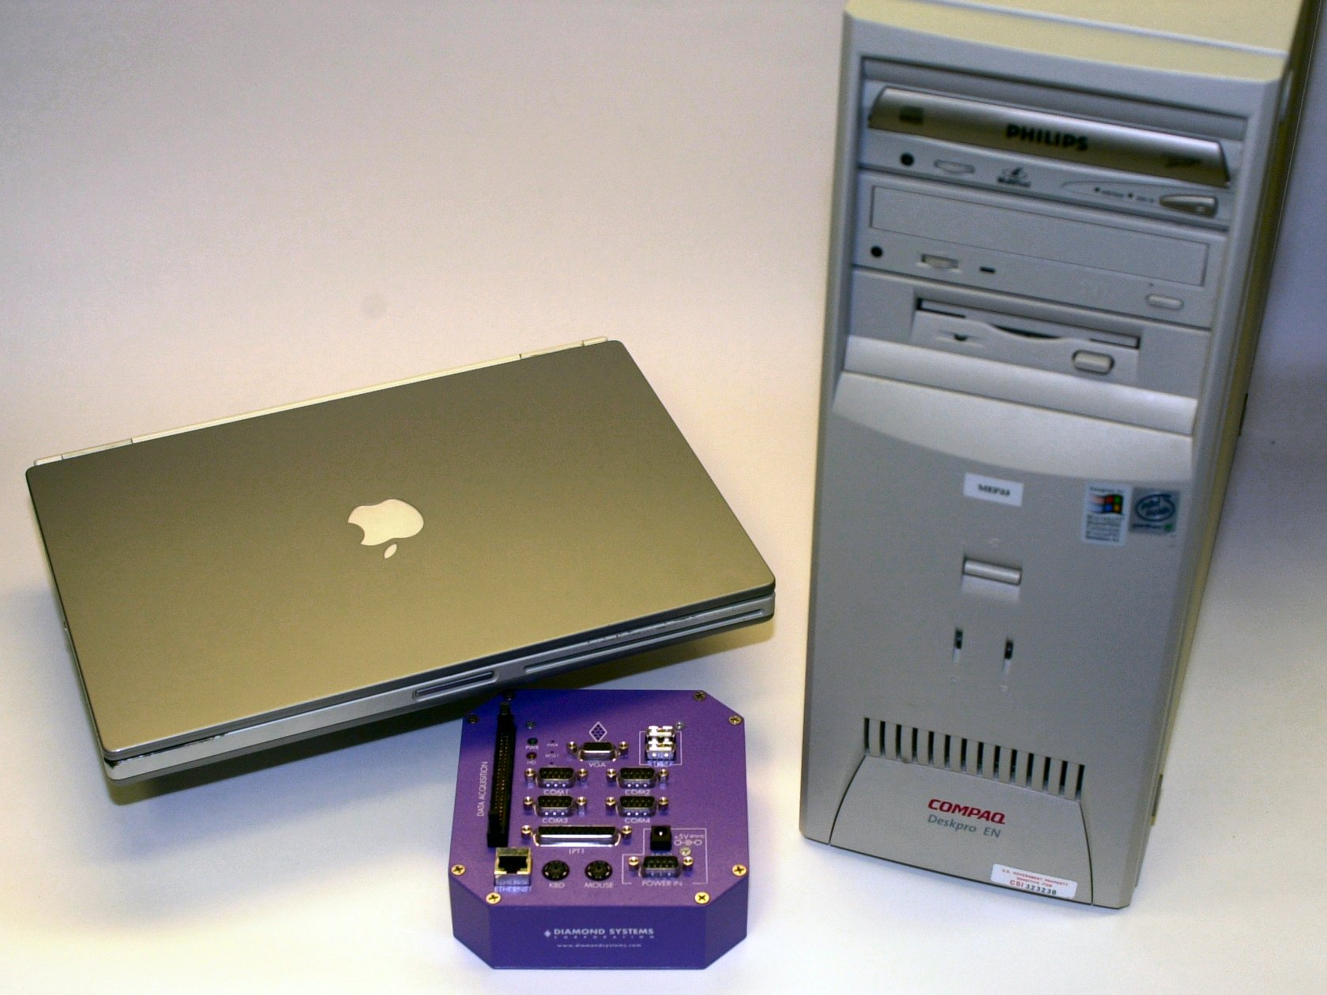




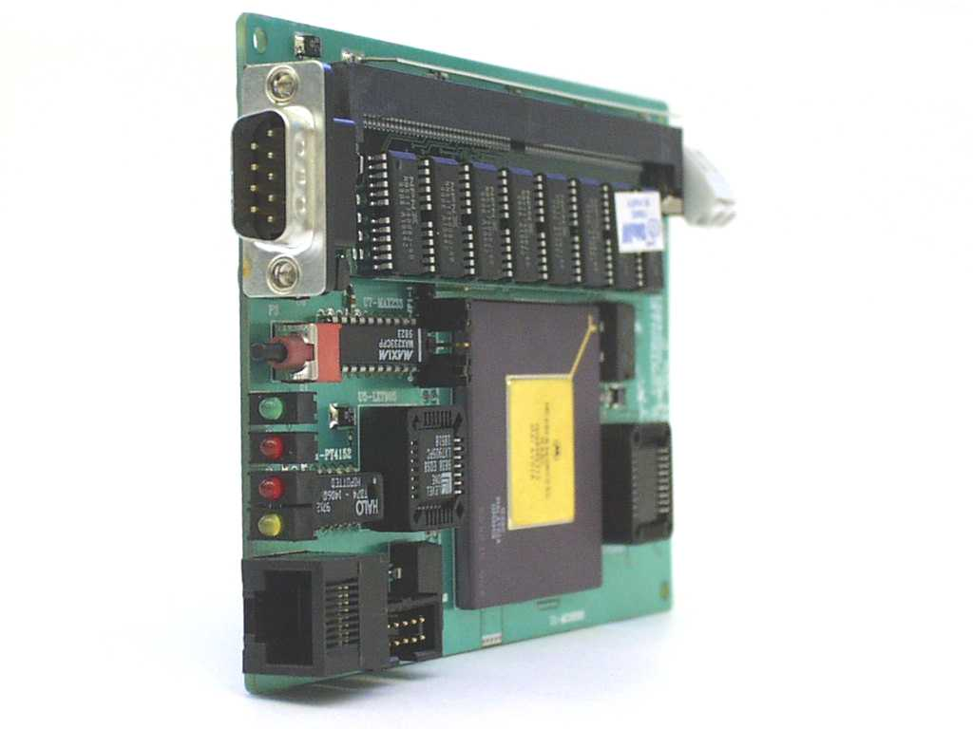
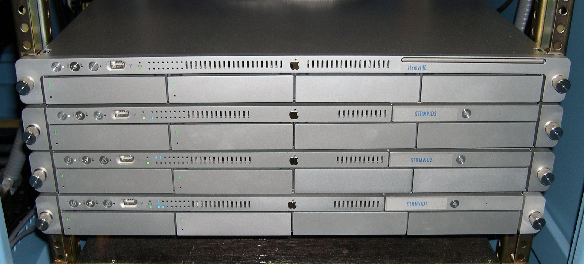
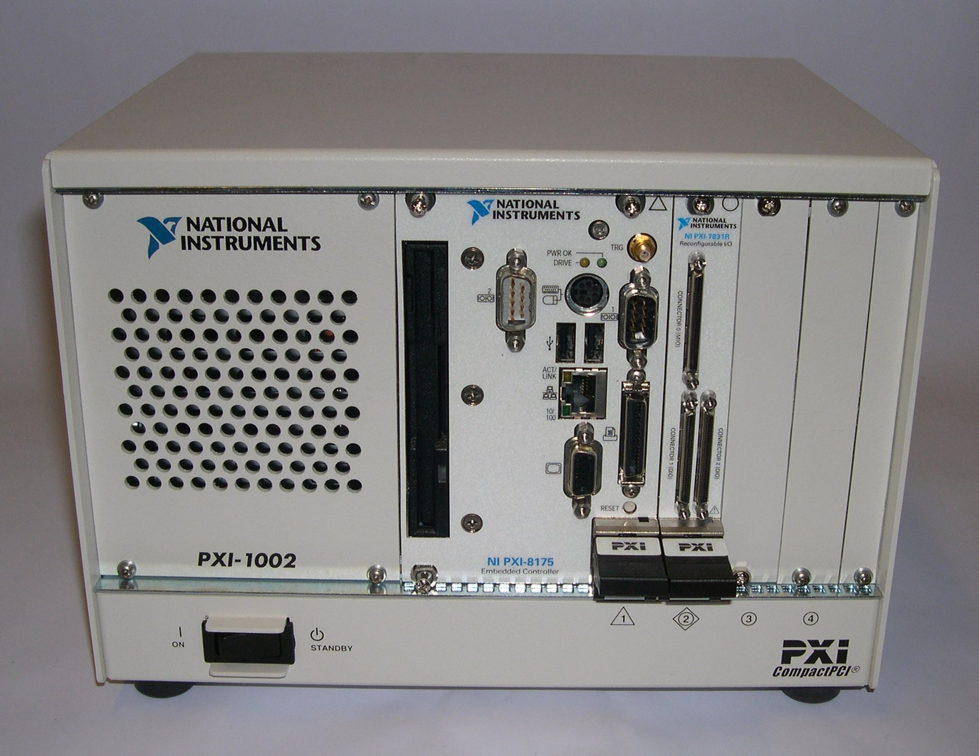
Typical Realization of an EPICS System
EPICS Base is portable and runs on most major operating systems
IOC
IOC
CAS
IOC
CAS
IOC
Commercial Instruments
Custom Chassis/Panels
RTEMS
Technical Equipment

